Slide 1
Generative Geniuses
Team Members
Harish Sharma
Cloud Application Architect
Kunal Gautam
Principal Architect Analytics
Paritosh Mehta
IoT Architect
Tanya Pahuja
Vishal Gupta
TAM
Senior Solution Architect
Shikha Nautiyal
Account Manager

Slide 2
Idea!
Who is customer/audience? Health insurance companies & TPA
What is the problem? Claim settlement is manual hence slow, error-prone and expensive
What does it solve? Accelerate claim settlement time, reducing claim processing cost, enhancing end customer experience by automating the process. Reducing cost will also help insurance to reimburse for small ticket claims like OPD.
How does it solve it? Gen AI enabled processing for insurance claims enables automation, optimizing operational costs, reducing manpower expenses, and facilitating efficient claim resolution by reducing claim time by more than 70%.

Slide 3
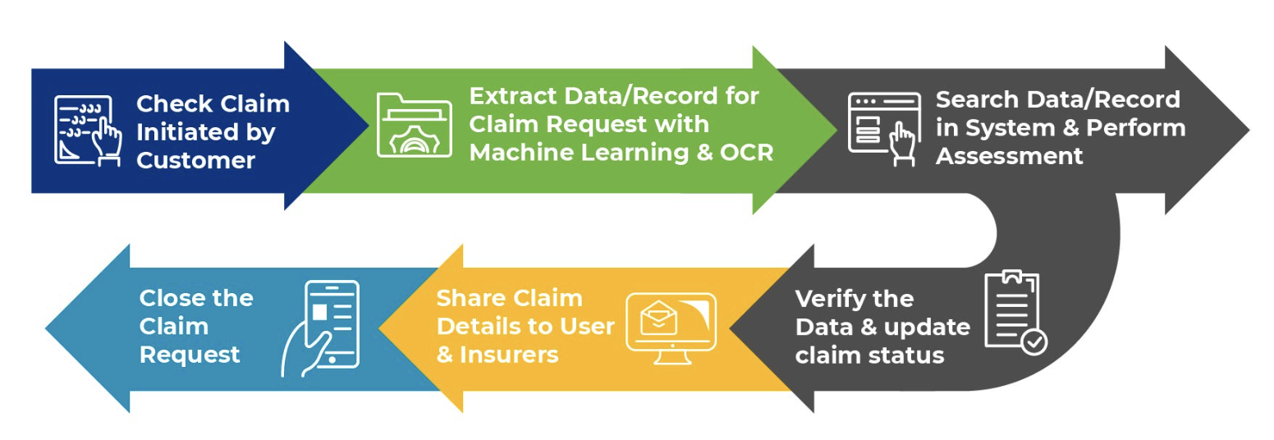
Current High Level process

Slide 4
Scale of India Medical insurance claims
Volume of medical insurance claims in 2023 : 2.36 crore (44% reimbursements)
Average processing time: 30 days (recommended by IRDAI)
The average amount paid per claim was
Rs 30,087
Cost of processing one medical claim is Rs 500 Small ticket claims like OPD is not possible.
Source: Economics Times
Notes:
Nw, b4 we talk about our soolution, lets take take a step back and understand little bit about the health insurance industry in India.
Talking about the scale

Slide 5
Business Case
Projected Time Savings: 70% saving
Projected $ Savings: Rs. 182 crore (assuming 50% claims get processed faster with 70% time saving)
Market Potential: 29 insurance companies and 18 TPAs

Slide 6
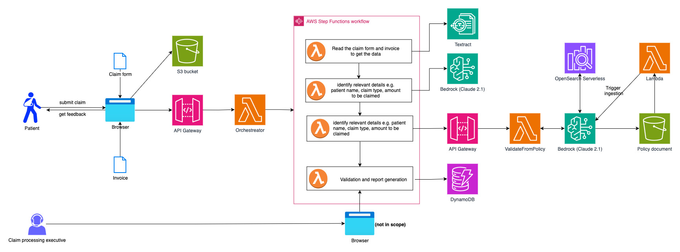
Technical Architecture Snapshot

Slide 7
Demo Time!

Slide 8
Q & A

